Slide 1
3D Visualisation of Sensor Information on Google Android platform
  Final Year BEng Project
2009-05-15
Maciej Gryka, University of Surrey, ee51mg@surrey.ac.uk

Slide 2
Content
  Introduction to Google Android
  The aim of the project
  Application design
  Development
  Results and further work
2009-05-15
Maciej Gryka, University of Surrey, ee51mg@surrey.ac.uk

Slide 3
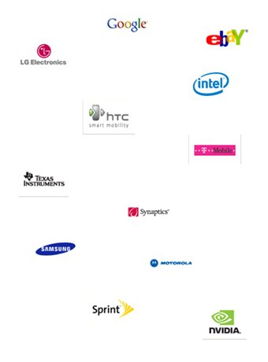
What is Android?
Developed by Open Handset Alliance
(mainly Google)
Open-source and freely available
Two Android devices to date, more coming
soon
Based on Linux, includes popular libraries
(OpenGL)
Applications written in Java
2009-05-15
Maciej Gryka, University of Surrey, ee51mg@surrey.ac.uk

Slide 4
Project Objectives
Build an application for 3D building monitoring
  Connect to the data repository over the Internet
  Interpret data in OWL format
  Visualise data on 3D building model
2009-05-15
Maciej Gryka, University of Surrey, ee51mg@surrey.ac.uk

Slide 5
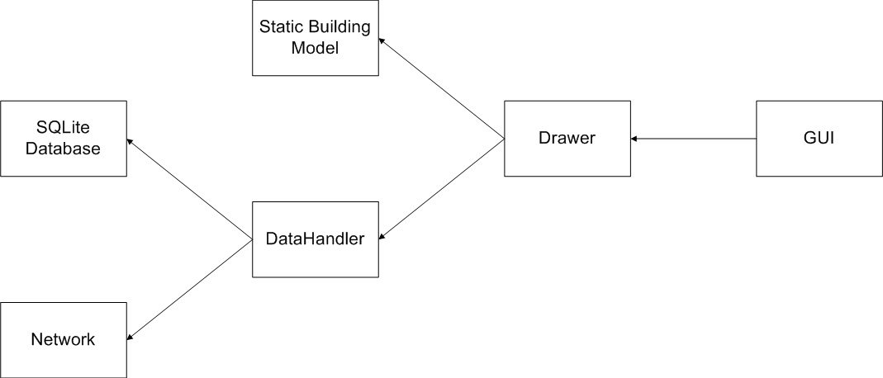
High Level Design
2009-05-15
Maciej Gryka, University of Surrey, ee51mg@surrey.ac.uk

Slide 6
Implementation Details
Creating the 3D model
Converting and importing the model
Displaying 3D objects on Android
User Interface
Handling the measurement data
2009-05-15
Maciej Gryka, University of Surrey, ee51mg@surrey.ac.uk

Slide 7
Demonstration
2009-05-15
Maciej Gryka, University of Surrey, ee51mg@surrey.ac.uk

Slide 8
Next Steps
Additional levels
Lighting
User-changeable values for actuators
True real-time monitoring (repository-pushed updates)
2009-05-15
Maciej Gryka, University of Surrey, ee51mg@surrey.ac.uk

Slide 9
Conclusions
Application successfully developed – contains functionality desired by the
client and received positive feedback.
Development of the critical features completed by the deadline.
Transitioning the project ownership to continue the development.
2009-05-15
Maciej Gryka, University of Surrey, ee51mg@surrey.ac.uk

Slide 10
Thank you
2009-05-15
Maciej Gryka, University of Surrey, ee51mg@surrey.ac.uk

